Slide 1


Title Slide
ITk Cooling (AUW)
Pixel Inner System
Rafael Coelho Lopes de Sa
Anirudh J. Uppal
With inputs from Allen Zhao, Grant Lloyd, Steven Welch, and Neal Hartman
Apr 24th 2020

Slide 2
Requirements
Cooling requirements in the Pixel Inner System are set by the following:
Runaway temperature of the sensor
Allowed current into front-end chip
Temperature on front-end chip (under discussion)
For the Pixel Inner System, item (2.) is usually the limiting factor. Ongoing discussions to set the exact requirement.
The modeling is done in two parts:
Thermo-electrical FEA model to describe heat flow from sensor to coolant
Thermo-fluidic model to describe heat absorption by the coolant and flow properties. Also important to model pressure drop in capillary and evaporator (targeting total dP ~ 10bar and capillary dP ~ 8bar)
This talk focuses on the thermo-fluidic modeling
The most recent update with the Inner System thermo-electrical simulation is here: http://cern.ch/go/t6NV
Here we focus on the region between PP1, not outside.
Most of the results present here were obtained to guide design. There are details to be updated. I tried to highlight them when relevant.

Slide 3
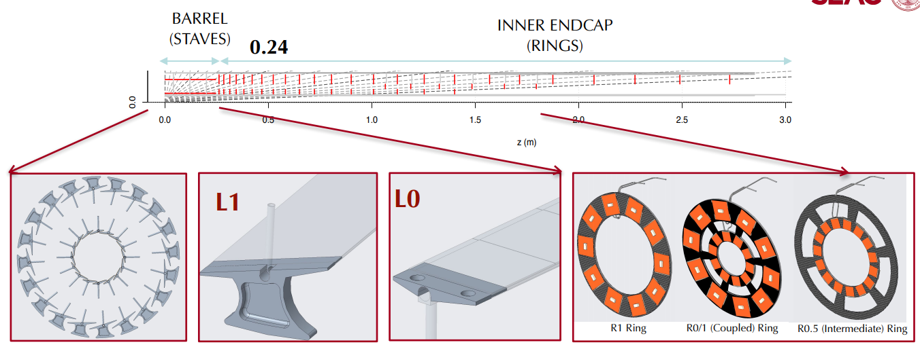
Pixel Local Supports
The Pixel Inner System has a large number of mechanical structures with quite different heat load
* The models and layout shown here are outdated, but the changes are small.
* Additional rings for luminosity monitors with very low power usage.
* Numbers here obtained with 0.7 W/cm²
Total power (used for thermo-fluidic modeling) per local support
L1 stave: 135W/LS
L0 stave: 67W/LS
R1 ring: 224W/LS
R0/1 ring: 274W/LS
R0.5 ring: 84W/LS

Slide 4
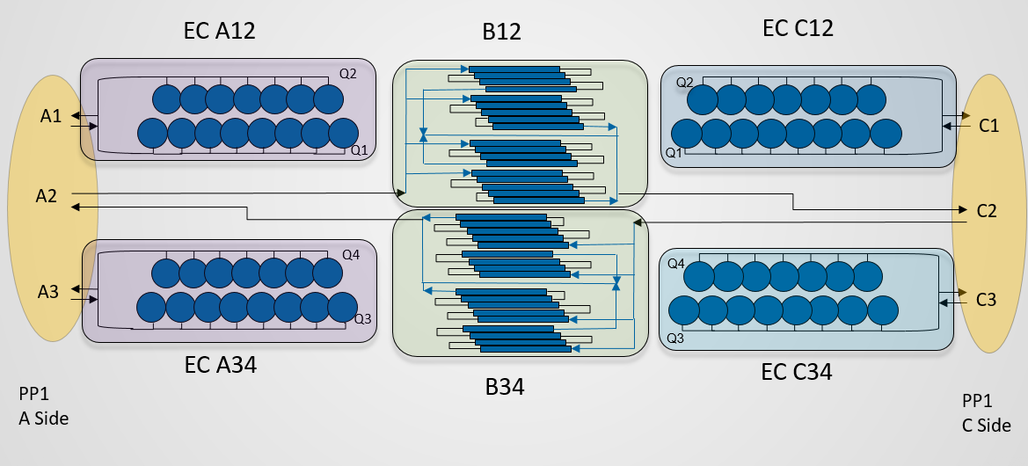
Cooling design
The large number of different structures make the cooling strategy challenging since different solutions are necessary. The diagram below shows a high level diagram of the strategy.
3 connections in each PP1.
Pixel Inner System built in quarter (shells). Cooling in half (cylinders)
Barrel staves receive coolant in series.
Endcap rings receive coolant in parallel.
Cross-flow in the barrel.
Diagram copied from Allen Zhao (ANL)
https://indico.cern.ch/event/865155/contributions/3645245/attachments/1951100/3238998/Inner_System_Barrel_Manifolding_11252019.pptx

Slide 5
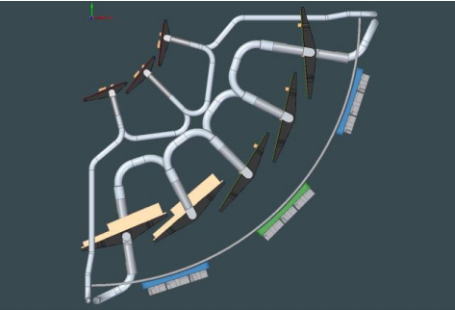
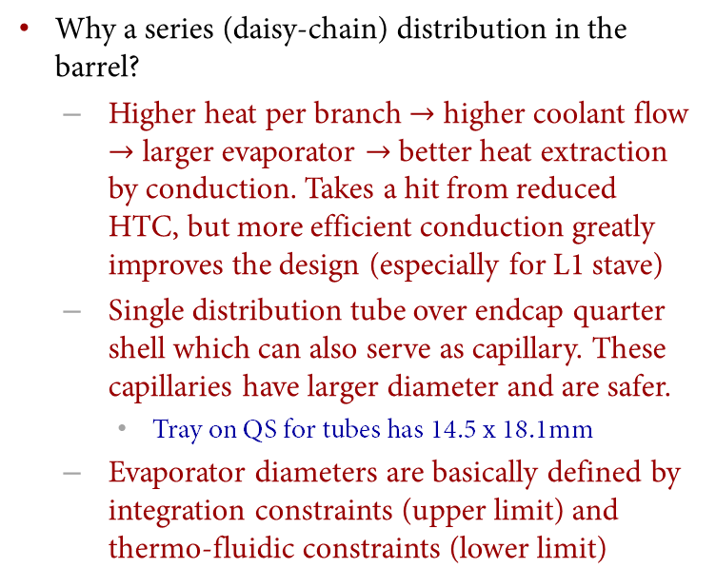
Barrel cooling design
Why a series (daisy-chain) distribution in the barrel?
Higher heat per branch $→$ higher coolant flow $→$ larger evaporator $→$ better heat extraction by conduction. Takes a hit from reduced HTC, but more efficient conduction greatly improves the design (especially for L1 stave)
Single distribution tube over endcap quarter shell which can also serve as capillary. These capillaries have larger diameter and are safer.
Tray on QS for tubes has 14.5 x 18.1mm
Evaporator diameters are basically defined by integration constraints (upper limit) and thermo-fluidic constraints (lower limit)
Diagram from Grant Lloyd (SLAC)
L1 stave evaporator ID: 3.0mm
(5 staves in series)
L0 stave evaporator ID: 2.3mm
(3 staves in series)

Slide 6
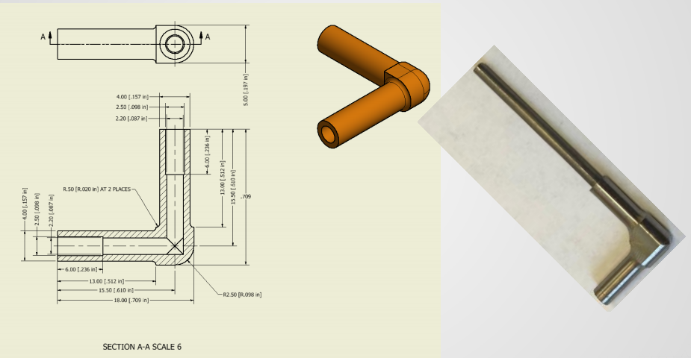
Simulations and demonstrator
Simulations performed with private code very similar to CoBra
1D model simulated with Thome correlations
No modeling of tube roughness
No modeling of elbow connectors
CO2 “set” temperature: -35oC (not -40oC… maybe relevant given the heat exchanger discussion… to be updated)
Flow in each branch: 1g/s per 100W
Simulations extended to manifolds
No thermo-fluidic demonstrator performed yet for Pixel Inner System
No resources to prepare demonstrator before the several Local Support prototypes are ready (prototypes 19-0, 19-1, and 19-2)
Currently scheduled for later this year. But COVID closures will have an impact on these plans.

Slide 7
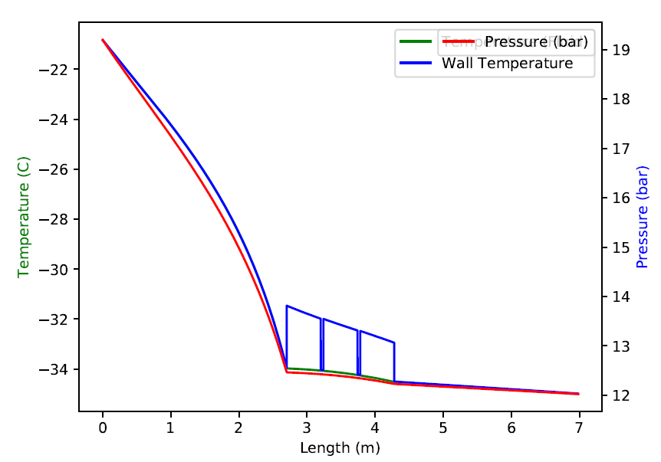
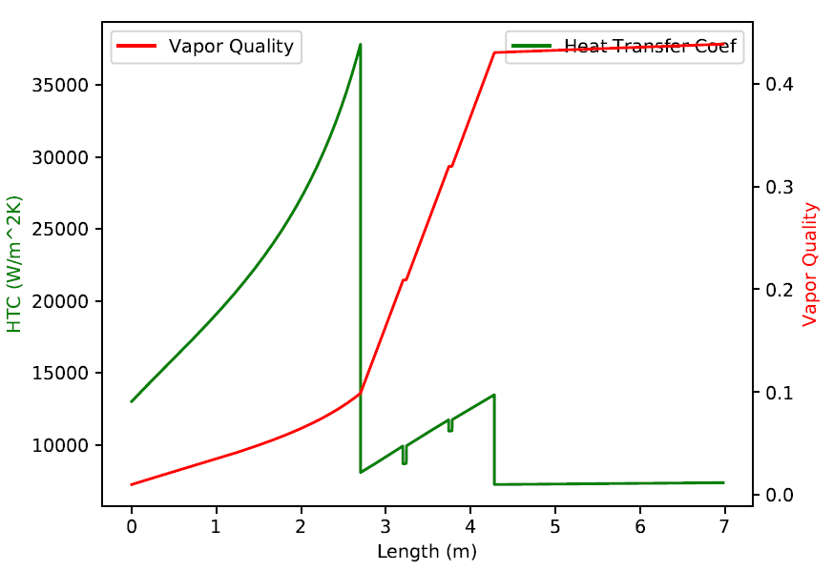
Result for L0 staves
ATTENTION: The simulations presented here have 2-phase already in the beginning of the capillary. This will be fixed soon.
Capillary
ID = 0.8mm
Length = 2.7m (full QS)
Environmental temp = -10oC
Exhaust tube ID = 3mm
Capillaries only absorb heat from convection
Very little dependence on environmental temperature.
Little dependence on whether or not capillary is insulated.
Very sensitive to capillary ID
Total dP(ID=0.75mm) = 12.1 bar
Total dP(ID=0.8mm) = 7.2 bar
ATTENTION 2: We will not try to fine tune the 10 bar here. The dimensions of the system are still too open.

Slide 8
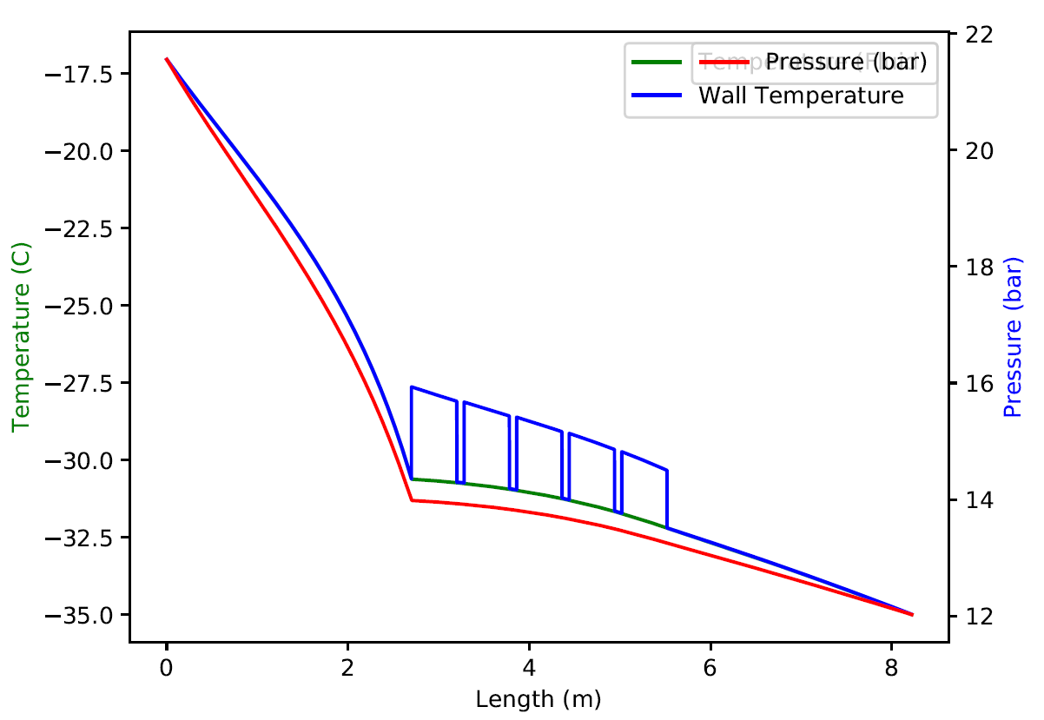
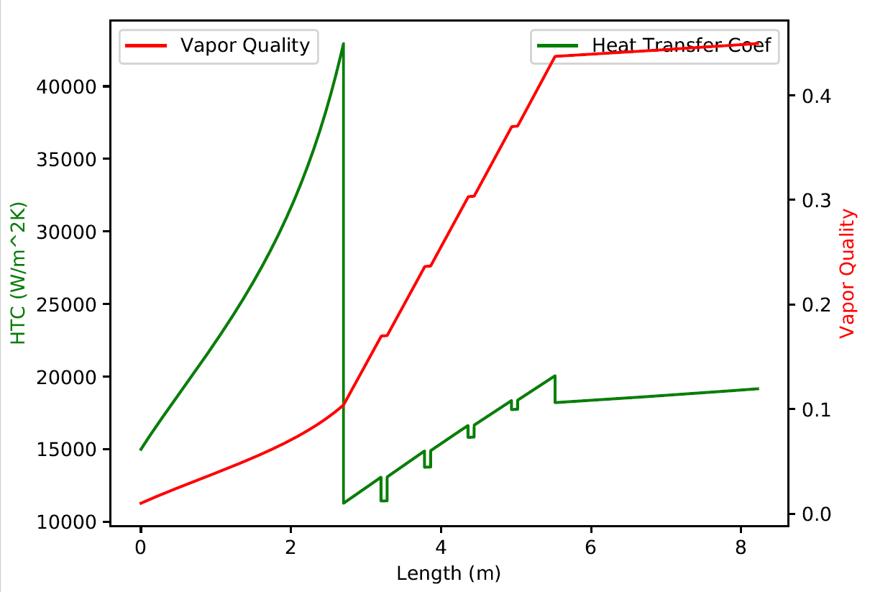
Result for L1 staves
Capillary
ID = 1.2mm
Length = 2.7m (full QS)
Environmental temp = -10oC
Exhaust tube ID = 3mm
Capillaries only absorb heat from convection
Very little dependence on environmental temperature.
Little dependence on whether or not capillary is insulated.
Very sensitive to capillary ID and length
Total dP(ID=1.1mm) = 18.6 bar
Total dP(ID=1.2mm) = 9.5 bar
NOTE: It is possible to use the same capillary as the L0 stave (ID=0.8mm) if length is reduced.

Slide 9
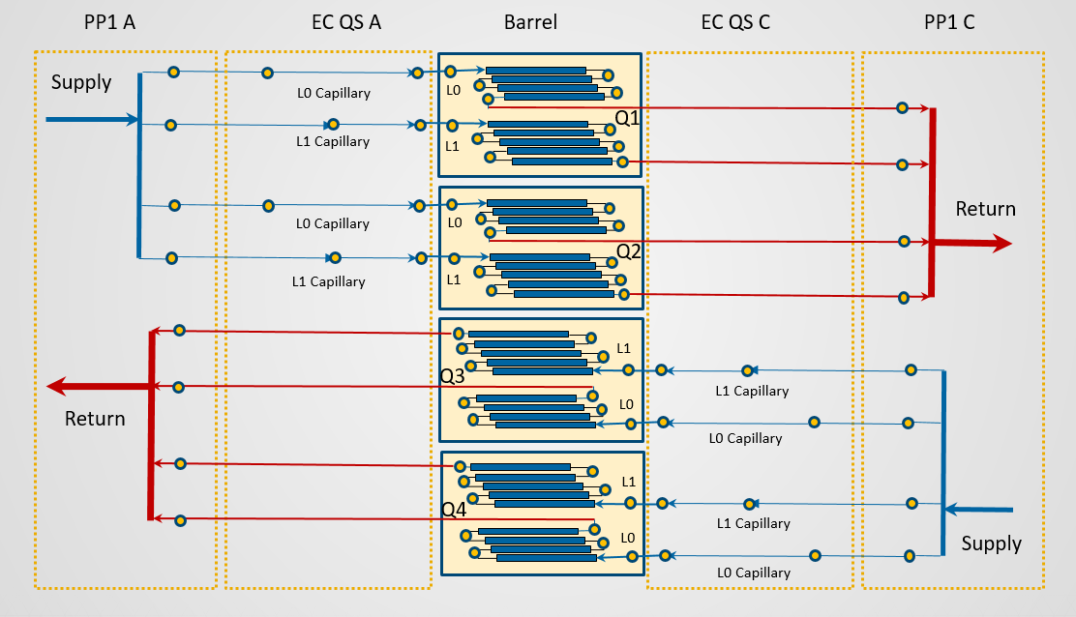
Reduced capillary for L1 staves
We can have both L0 and L1 capillaries with ID=0.8mm by reducing the L1 capillary.
2.7m for L0
0.4m for L1
This particular configuration has not been simulated yet.
Need more inputs from system designers.

Slide 10
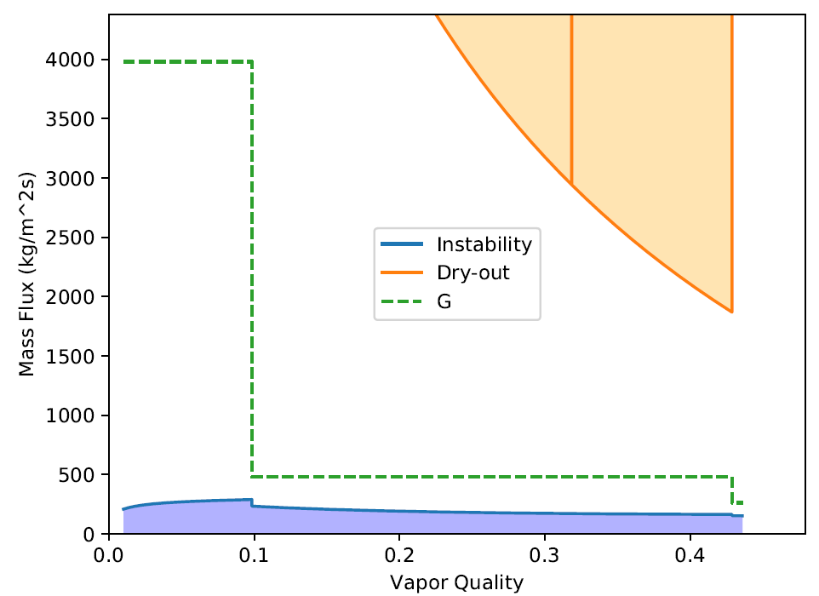
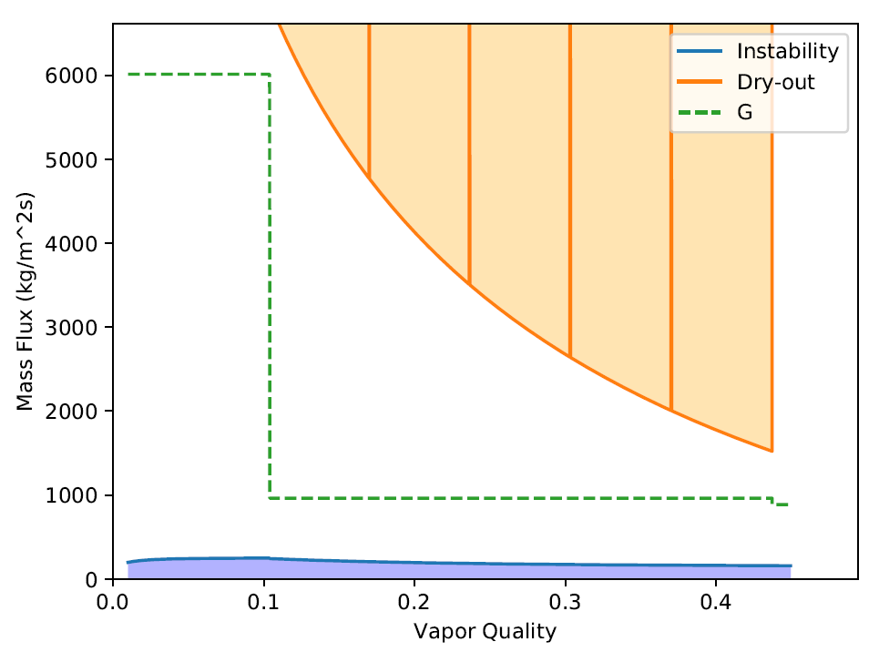
Flow quality in the barrel
L0 staves (ID=2.3mm)
L1 staves (ID=3mm)
ID for L1 stave evaporator in safe region
ID for L0 stave closer to instability region (2.3mm was chosen based on market availability and may be re-evaluated)

Slide 11
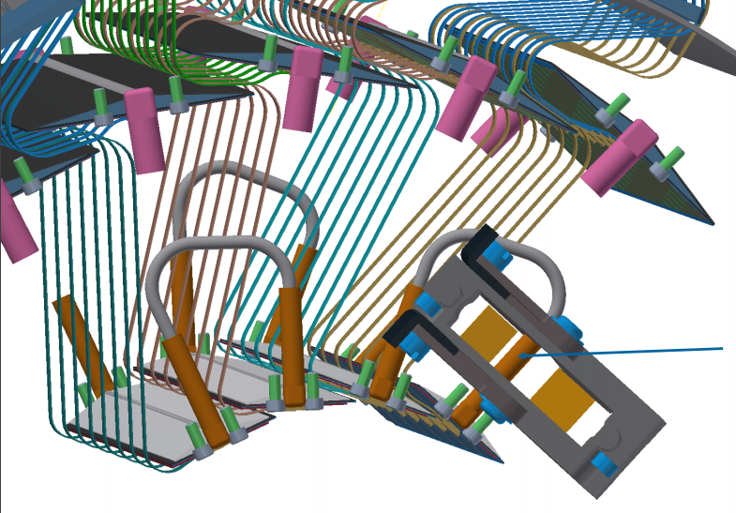
Barrel manifold
L1 and L0 stave branches are manifolded close to PP1
We simulate a half-cylinder barrel manifold:
(2x) 5 L1 stave 3mm evaporators in series and 1.2mm/2.7m capillaries
(2x) 3 L0 stave 2.3mm evaporators in series and 0.8mm/2.7m capillaries.
Total CO₂ flow in barrel PP1 connection 17.4 g/s (in each direction).
Small changes in flows. Total dP = 8.9 bar with multiline simulation (done here more to validate multiline simulation algorithm, to be honest).
Of course, this is not the 10 bar in the requirements.
But given uncertainties in the design, this is enough to provide necessary inputs.

Slide 12
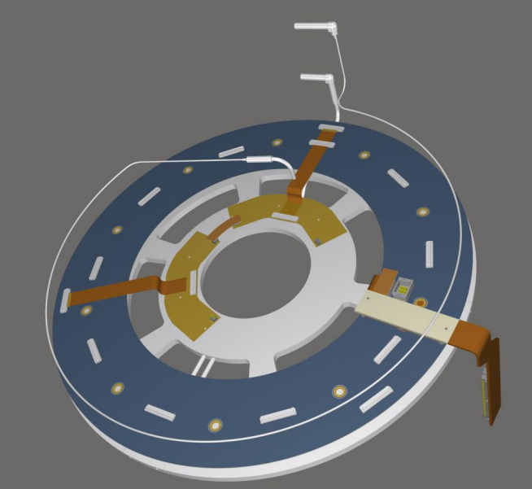
Endcap cooling design
Different strategy. Each local support on a manifold branch. Capillary length fixed by mechanical/integration design (72 cm).
The power dissipated in each branch can vary wildly (from 224W in R0/1 coupled ring to 84W in R0.5 intermediate ring). Very difficult to find common dimensions for evaporators and capillaries.
Number of local supports on each QS varies:
Q1: 4 R0/1, 2R0.5, 2R1
Q2: 4 R0/1, 2R0.5, 2R1
Q3: 4 R0/1, 1R0.5, 2R1
Q4: 3 R0/1, 1R0.5, 2R1
Diagram from Steven Welch (Oklahoma State)
A1/C1 17.6 + 17.6 = 35.2 g/s
[CO2 flow in each PP1 feedthrought used for thermo-fluidic modeling]
A2/C2 8.8 + 8.8 = 17.4 g/s
A3/C3 16.7 + 13.9 = 30.6 g/s

Slide 13
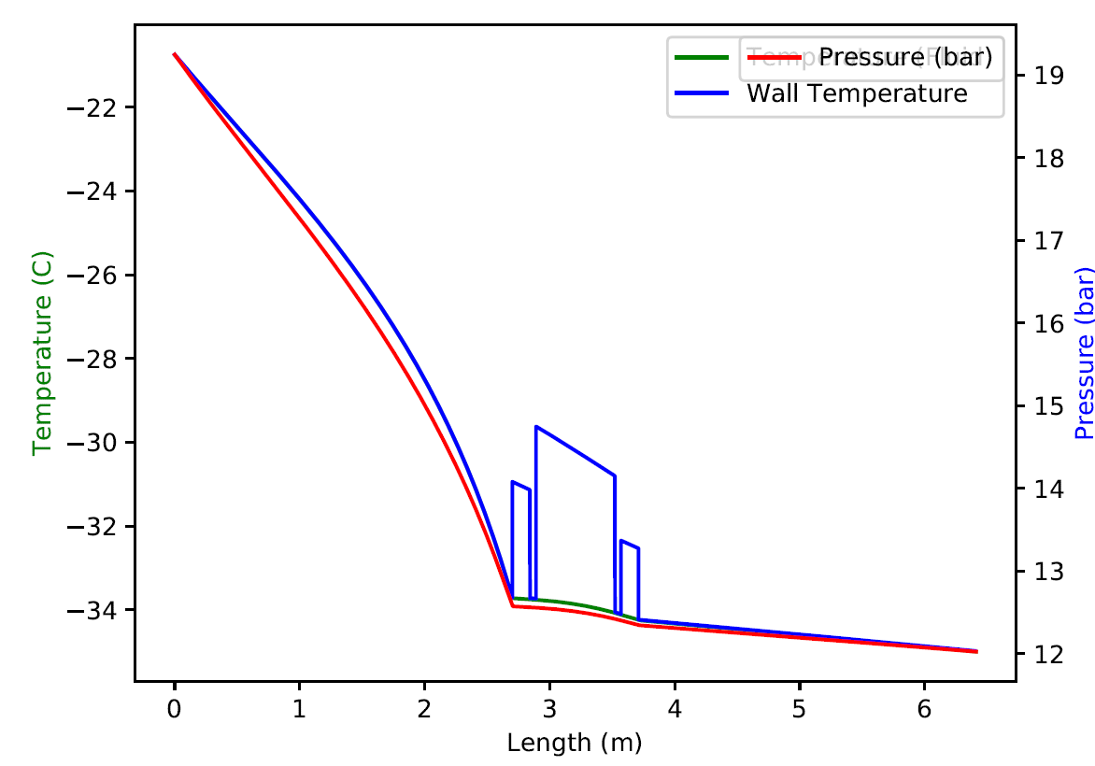
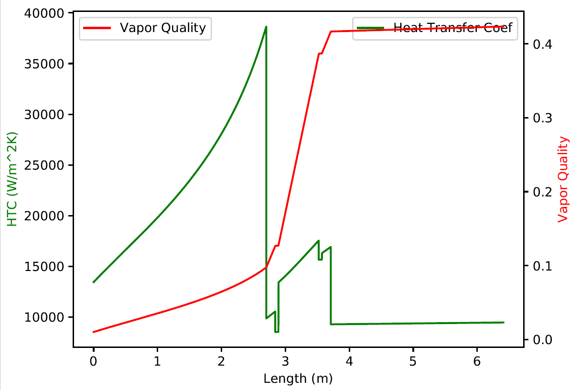
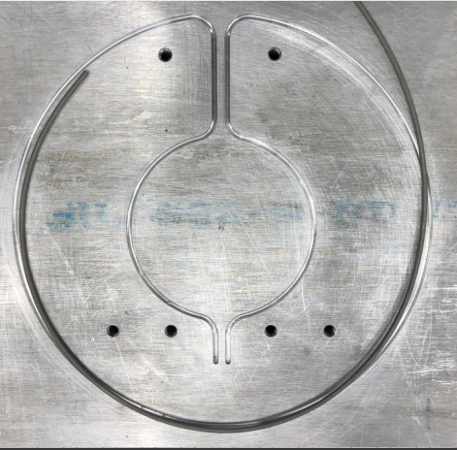
Results for R0/1 (coupled ring)
We use the same evaporator as for the L0 stave: ID = 2.3mm
Capillary always non-insulated (but negligible effect) with ID=0.65mm. Again, large dP dependence with ID.
Total dP(0.6mm) = 17.2 bar, total dP(0.65mm) = 8.95 bar.
Difference in CO2 temperature on each side of R0/1-0 ring ~ 1ºC
Difference in HTC: ~ 5kW/m²K
Need to propagate this observation to conductive simulation to evaluate temperature difference in the sensors.

Slide 14
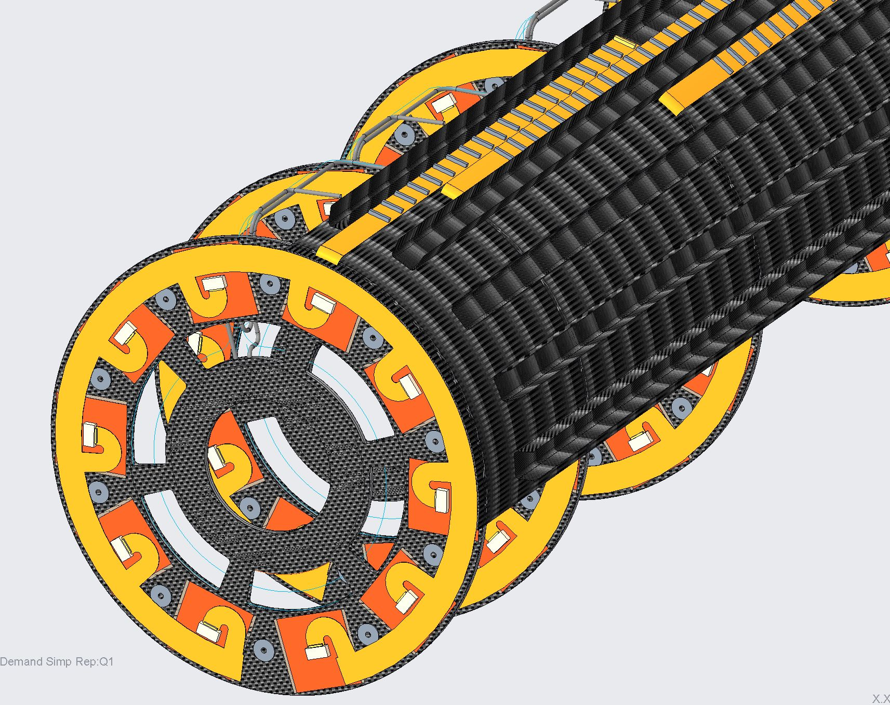
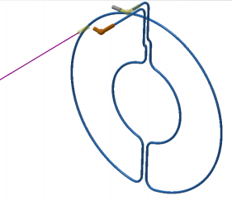
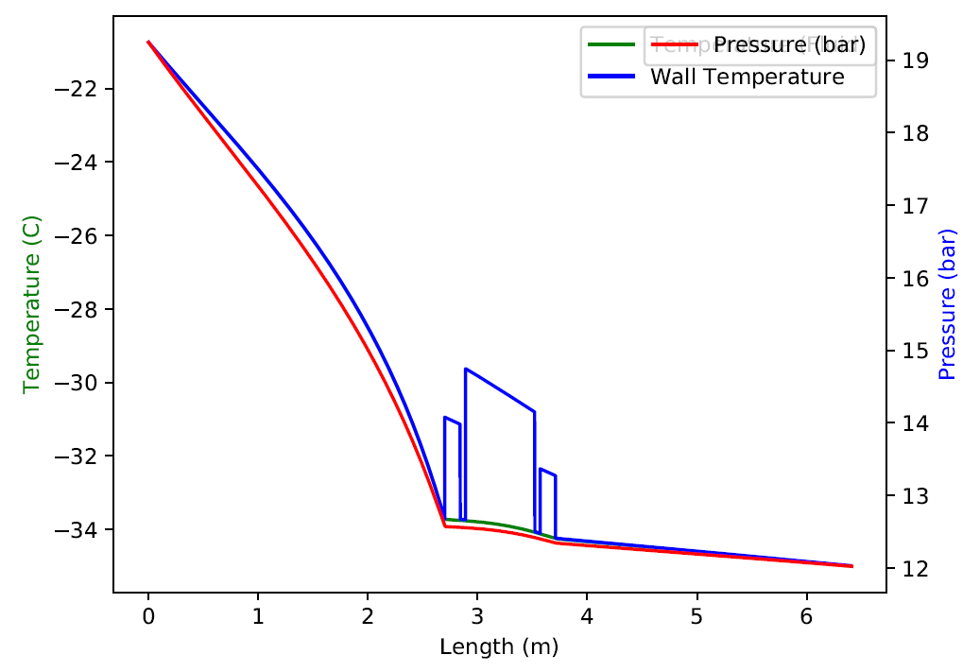
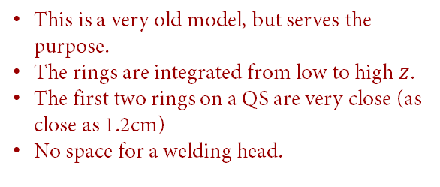
Coupled ring integration
The first coupled ring may need its own distribution.
Very similar behavior with
Capillary ID = 0.9mm
Length = 2.7m
This is a very old model, but serves the purpose.
The rings are integrated from low to high $z$.
The first two rings on a QS are very close (as close as 1.2cm)
No space for a welding head.

Slide 15
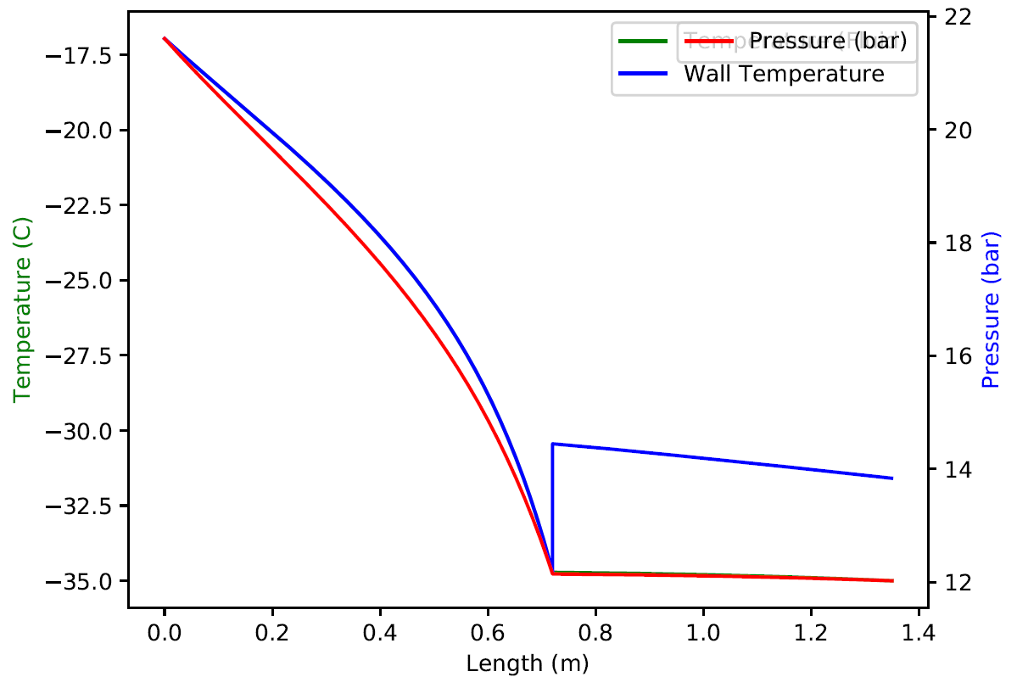
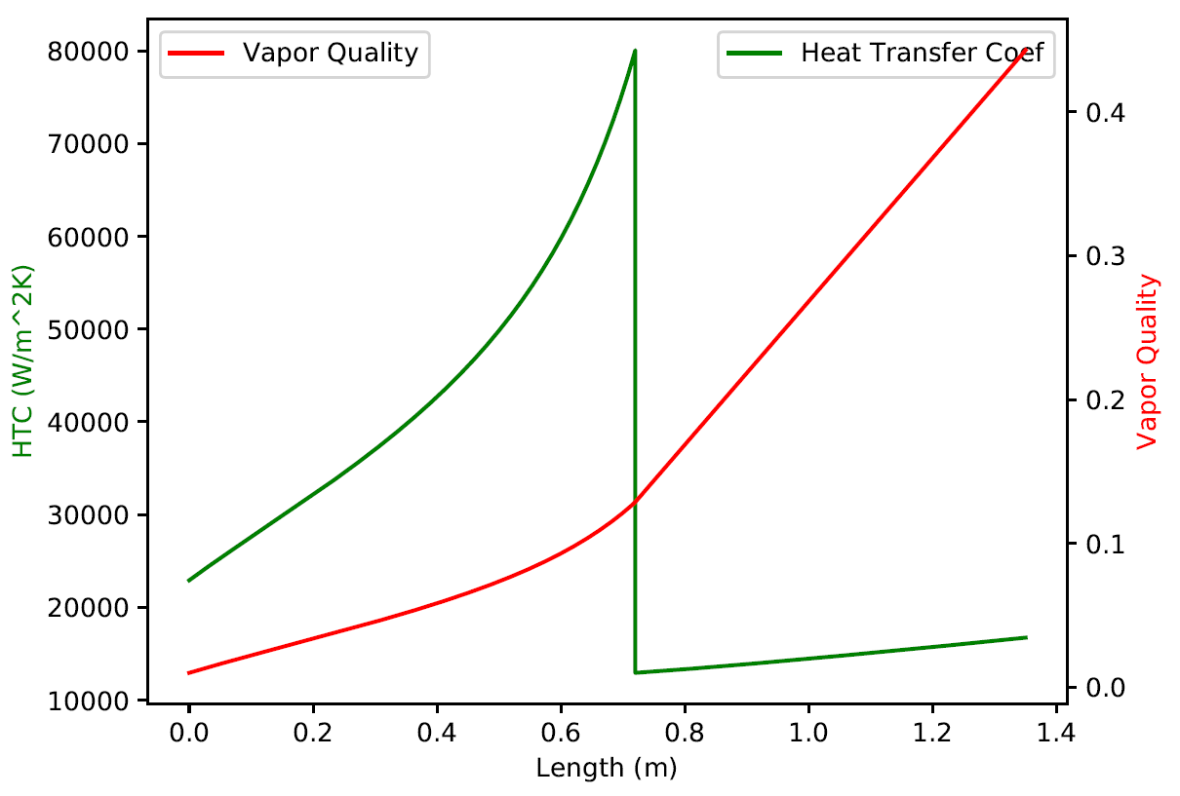
R1 Ring
No surprises here, but can’t use the same capillary as coupled ring if welding points are exactly the same (current design).
ID = 0.6mm, length = 72cm

Slide 16
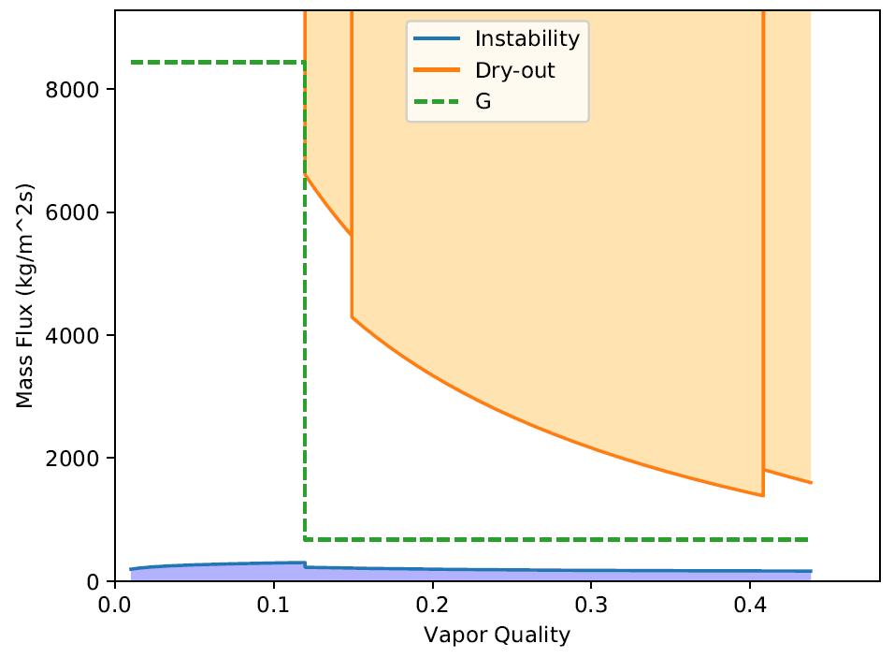
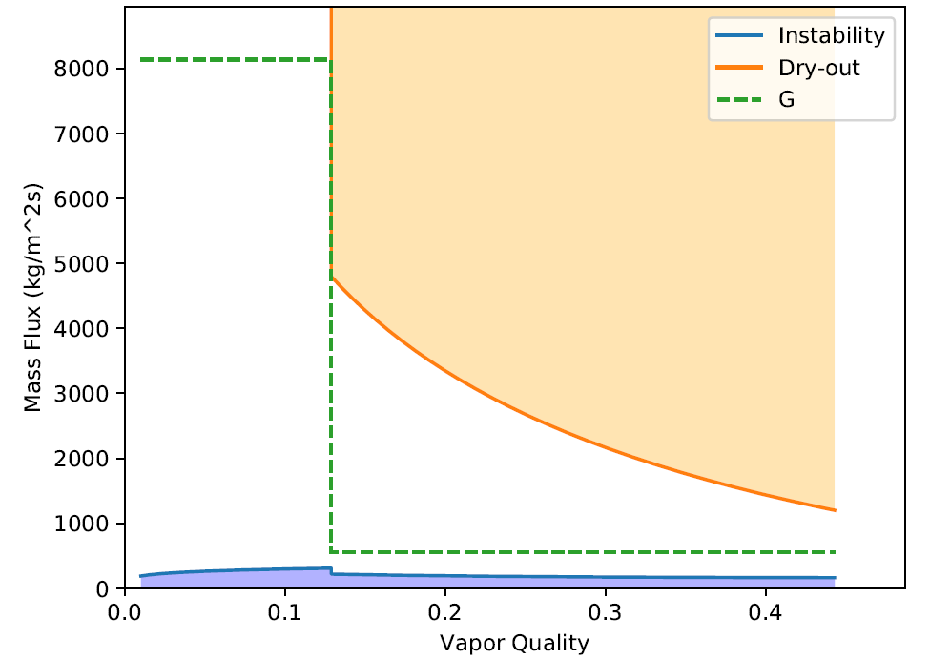
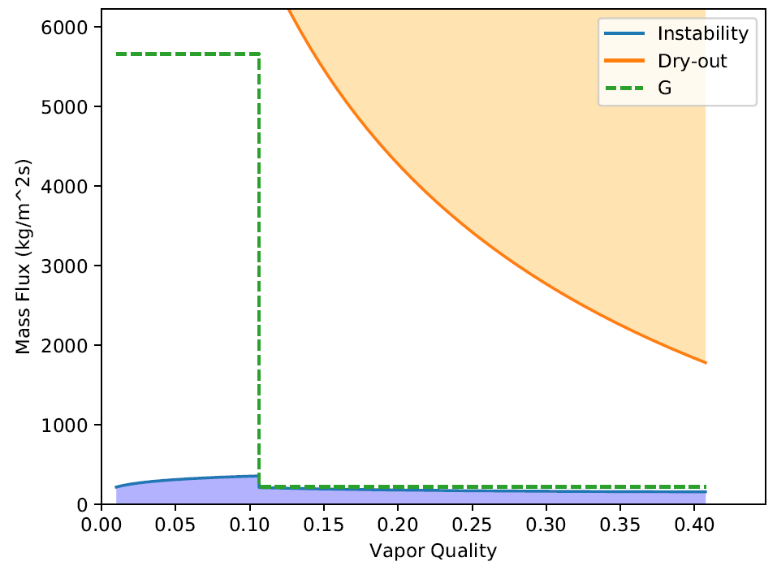
Evaporators for endcaps
R0/1 ring, evaporator ID=2.3mm
OK
R1 ring, evaporator ID=2.3mm
OK
R0.5 ring, evaporator ID=2.3mm
NOT OK

Slide 17
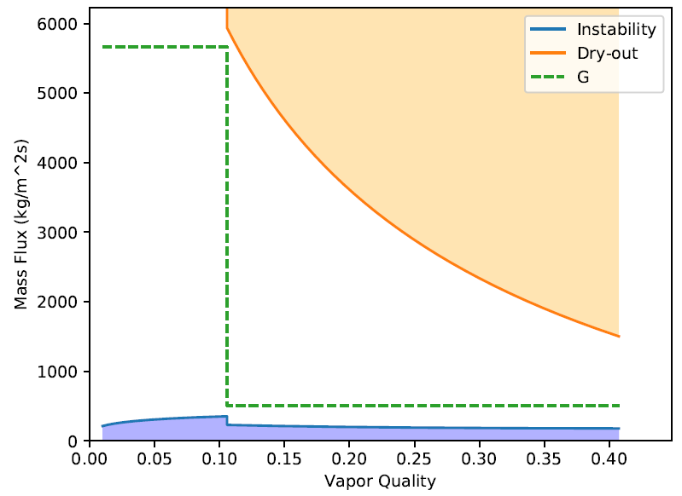
Evaporators for endcaps
The R0.5 intermediate ring will require smaller evaporators.
Design still to be prepared.
R0/1 ring, evaporator ID=2.3mm
OK
R1 ring, evaporator ID=2.3mm
OK
R0.5 ring, evaporator ID=1.5mm
OK

Slide 18
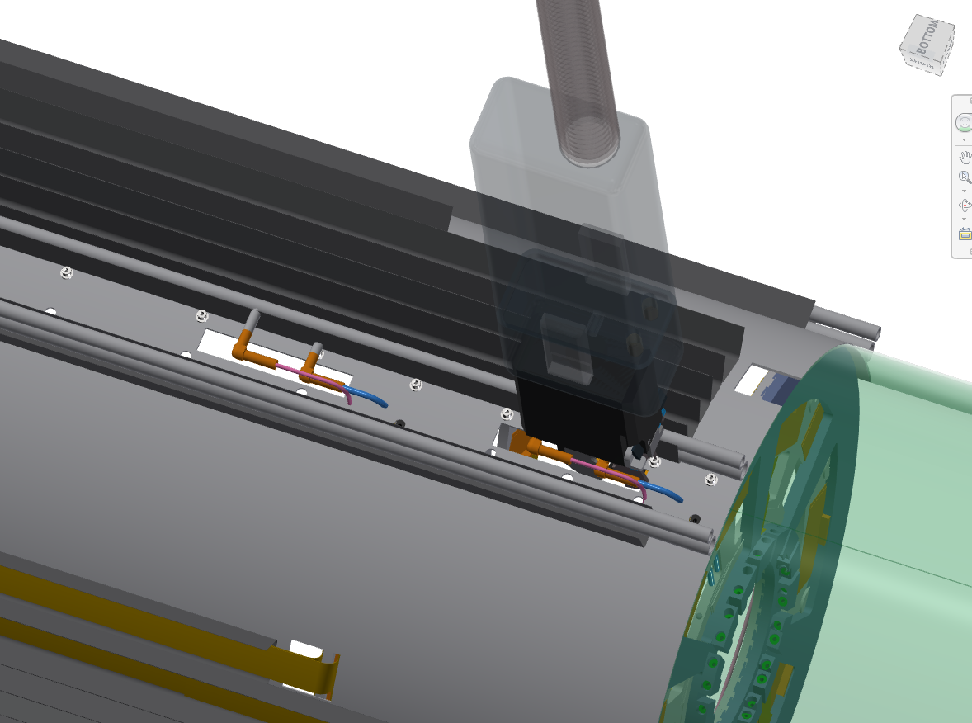
Endcap manifold
Endcap manifold based on a supply and return tubes modeled with ID=3mm and without heat exchange between them.
Pressure drop on spigots and elbows not modelled
Model only the 4 R0/1, 2R0.5, 2R1 case:
R0/1, evaporator ID = 2.3mm, capillary ID = 0.65mm
R1, evaporator ID = 2.3mm, capillary ID = 0.6mm
R0.5, evaporator ID = 1.5mm, capillary ID = 0.45mm
Once again, few changes. Total dP = 7.6 bar
Close to 10bar given the uncertainties in the model
Will become more precise as model develops.
As in the case of the barrel, no surprise (in the simulation) when branches are connected in the manifold.
Diagram from Allen Zhao (ANL)

Slide 19
Thermo-fluidic demonstrator plans
The current plan of the Pixel Inner System community is to break the thermo-fluidic in two parts.
First part (in time for Pixel Local Support FDR):
Test of dP in capillary + evaporator system. For the barrel, this almost everything because of the daisy-chaining of staves. For the endcap, less so.
The purpose is to validate capillary design with realistic conditions (elbows, connections, etc).
Second part (in time for Pixel Global Mechanics FDR):
Test of full manifolds (as suggested by CERN cooling group).
The purpose is to validate the manifold design.
Separation in two phases basically driven by availability of resources in the Inner System community.

Slide 20
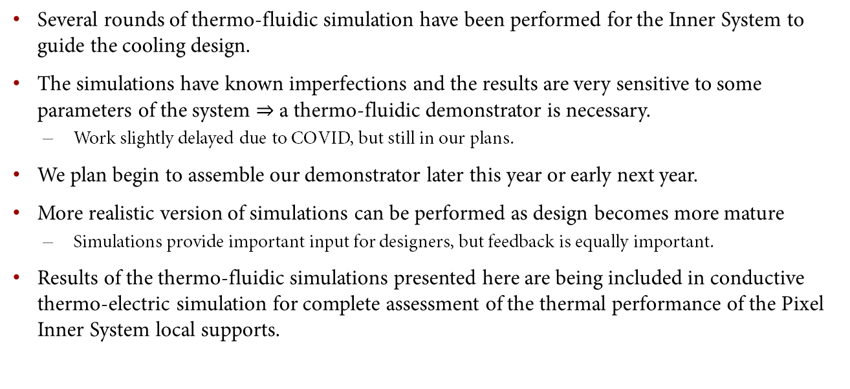
Conclusions
Several rounds of thermo-fluidic simulation have been performed for the Inner System to guide the cooling design.
The simulations have known imperfections and the results are very sensitive to some parameters of the system $⇒$ a thermo-fluidic demonstrator is necessary.
Work slightly delayed due to COVID, but still in our plans.
We plan begin to assemble our demonstrator later this year or early next year.
More realistic version of simulations can be performed as design becomes more mature
Simulations provide important input for designers, but feedback is equally important.
Results of the thermo-fluidic simulations presented here are being included in conductive thermo-electric simulation for complete assessment of the thermal performance of the Pixel Inner System local supports.
THANK YOU

